Slide 1
Virtual Presentation Round
FAIR & INTELLIGENT DELIVERY DISPATCH SYSTEM
Team Members
Varshini N P
Paveethraa B I
Srinithya V
Srithika P
Swetha S
Coimbatore Institute of Technology

Slide 2
Problem Statement
Existing delivery dispatch systems are designed primarily to be cost-effective, focusing on minimizing distance, fuel usage, and delivery time .
These systems ignore driver workload balance, repeatedly assigning complex or urgent routes to the same drivers.
Route assignment does not account for real delivery effort, such as package weight, traffic conditions, road quality, number of stops, or urgency.
Medical and high-priority deliveries lack structured prioritization.
Absence of workload tracking and transparency results in driver fatigue, dissatisfaction, and reduced efficiency .
There is no mechanism to provide fairness, flexibility, or controlled overrides in route assignment.

Slide 3
Proposed Solution
A Fair Dispatch System is proposed that assigns routes based on actual delivery effort instead of only cost metrics.
Each route is analyzed using the defined constraints and assigned a route rank: HIGH / MEDIUM / LOW , ensuring transparency.
The system maintains a driver workload history to prevent repeated overload of the same drivers.
Medical and urgent routes are automatically prioritized in assignment.
Drivers may request limited route‑difficulty adjustments using a token‑based mechanism, which are treated as soft preferences.
Token usage can be overridden by admin approval at worst cases, enabling controlled overrides with accountability.
The solution ensures fairness, efficiency, transparency, and sustainability , making it suitable for real-world deployment .

Slide 4

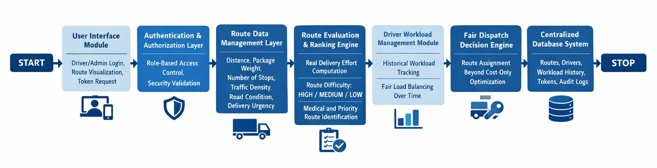
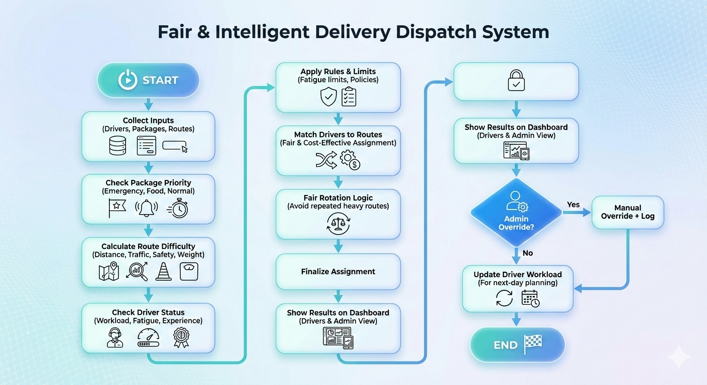
Process Architecture

Slide 5
Technology Stack
Layer | Tech / Method | Purpose
Core Platform | Python 3.x + Flask / FastAPI | Backend logic & system orchestration
Computation | Pandas + NumPy | Scoring, workload, fairness calculations
Route Evaluation | Weighted Scoring Model | Quantifies route & package difficulty
Fairness Tracking | Rolling Average / EWMA | Prevents driver overload over time
Scheduling Logic | Priority + Greedy + WRR | Efficient, fair route assignment
Rule Enforcement | Constraint-Based Rules | Fatigue limits, driver requests, admin rules
Explainability | Rule-Based XAI | Transparent assignment reasoning
User Interface | Streamlit Dashboard | Driver & admin interaction
Human Control | Admin Override Logging | Human-in-the-loop transparency

Slide 6
Novelty & Differentiation
Aspect | Existing Systems | Our Novel Approach / Differentiation
Fairness | Focus on daily efficiency | Balances driver effort over weeks/months for long-term fairness
Route Assignment | Fixed routes or proximity-based | Rotational allocation ensures exposure to all routes
Driver Input | Full choice or none | Limited preference signals (light/normal/heavy) guide assignments without breaking fairness
Route Difficulty | Based on distance/time | Multi-factor difficulty modeling: traffic, terrain, package weight, stops, handling
Learning & Familiarity | Relies on experienced drivers | Planned learning exposure for new drivers on tough routes
Urgency Handling | Overrides fairness | Emergency deliveries prioritized while maintaining workload balance
Admin Control | Unstructured manual override | Logged and bounded admin intervention for accountability
Workload Memory | No historical tracking | Tracks past effort to prevent repeated overload on same driver

Slide 7
References
Fair Task Allocation in Crowdsourced Delivery, University of Warwick
Fair task allocation in crowdsourced delivery, Basik, F. , Gedik, B. , Ferhatosmanoglu, H. ,Wu, K.
Workload Equity in Multi-Period Vehicle Routing Problems, University of Montreal, Canada
Workload Equity in Vehicle Routing Problems: A Survey and Analysis, University of Vienna, Austria
Fair Distribution of Delivery Orders, Pennsylvania State University
UPS Network Optimization Case Study (Last-Mile Focus) – Logistics network design and delivery strategy
The Strategic Role of Trucking in E-Commerce Fulfillment , Canamex Carbra Transportation Services, Olive Branch, Mississippi

